Slide 1
Lecture 3: Kalman filter

Slide 2
Likelihood statistics
Problem:
We often can’t write the probability of data given parameters
Examples:
Tag-recapture
What’s the probability of tagging an animal in 2008, seeing it again in 2010 and 2011, and then never seeing it again?
Time-series
What’s the probability distribution for escapement of chinook salmon in the snake river in 2011, given that you’ve sampled escapement from 1980-2010?
Occupancy
Three volunteers look for an endangered butterfly at a site, and only two find it. These volunteers sample at a new site, and none see the butterfly. What is the probability that is present but wasn’t detected?

Slide 3
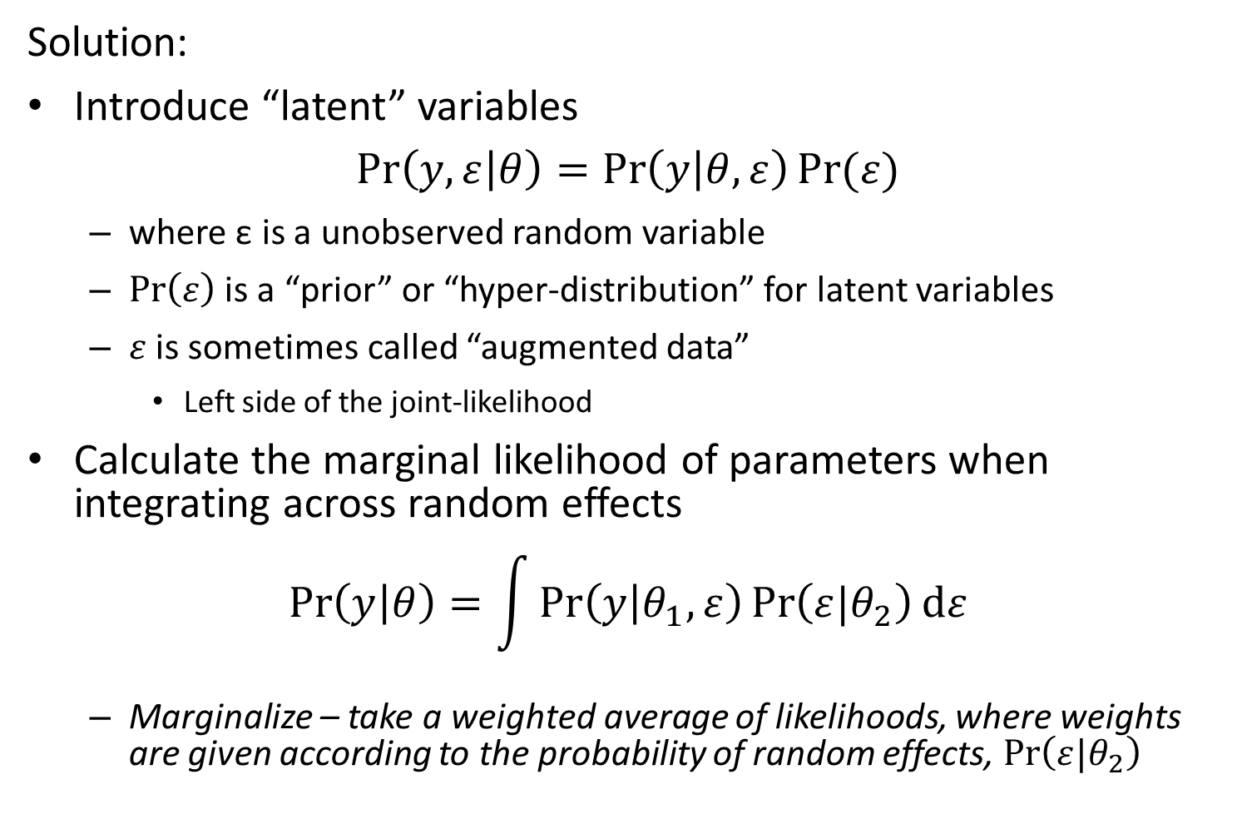
Likelihood statistics
Solution:
Introduce “latent” variables
$$\operatorname{Pr}\left(y,ε | θ\right)=\operatorname{Pr}\left(y | θ,ε\right)Pr⁡(ε)$$
where ε is a unobserved random variable
$\operatorname{Pr}\left(ε\right)$ is a “prior” or “hyper-distribution” for latent variables
$ε$ is sometimes called “augmented data”
Left side of the joint-likelihood
Calculate the marginal likelihood of parameters when integrating across random effects
$$\operatorname{Pr}\left(y | θ\right)=\int{\operatorname{Pr}\left(y | θ_{1},ε\right)\operatorname{Pr}\left(ε|θ_{2}\right)dε}$$
Marginalize – take a weighted average of likelihoods, where weights are given according to the probability of random effects, $\operatorname{Pr}\left(ε|θ_{2}\right)$

Slide 4
Definitions
Term | Definition
Random effect | Coefficient that is “exchangeable” with one or more other coefficients
Hyperdistribution | Distribution for “exchangeable” random effects
Exchangeable | No information is available to distinguish between residual variability in random effects
Fixed effect | Coefficient that is not exchangeable with others, and which hence is estimated without a hyperdistribution
Mixed-effect model | Model with both fixed and random effects

Slide 5
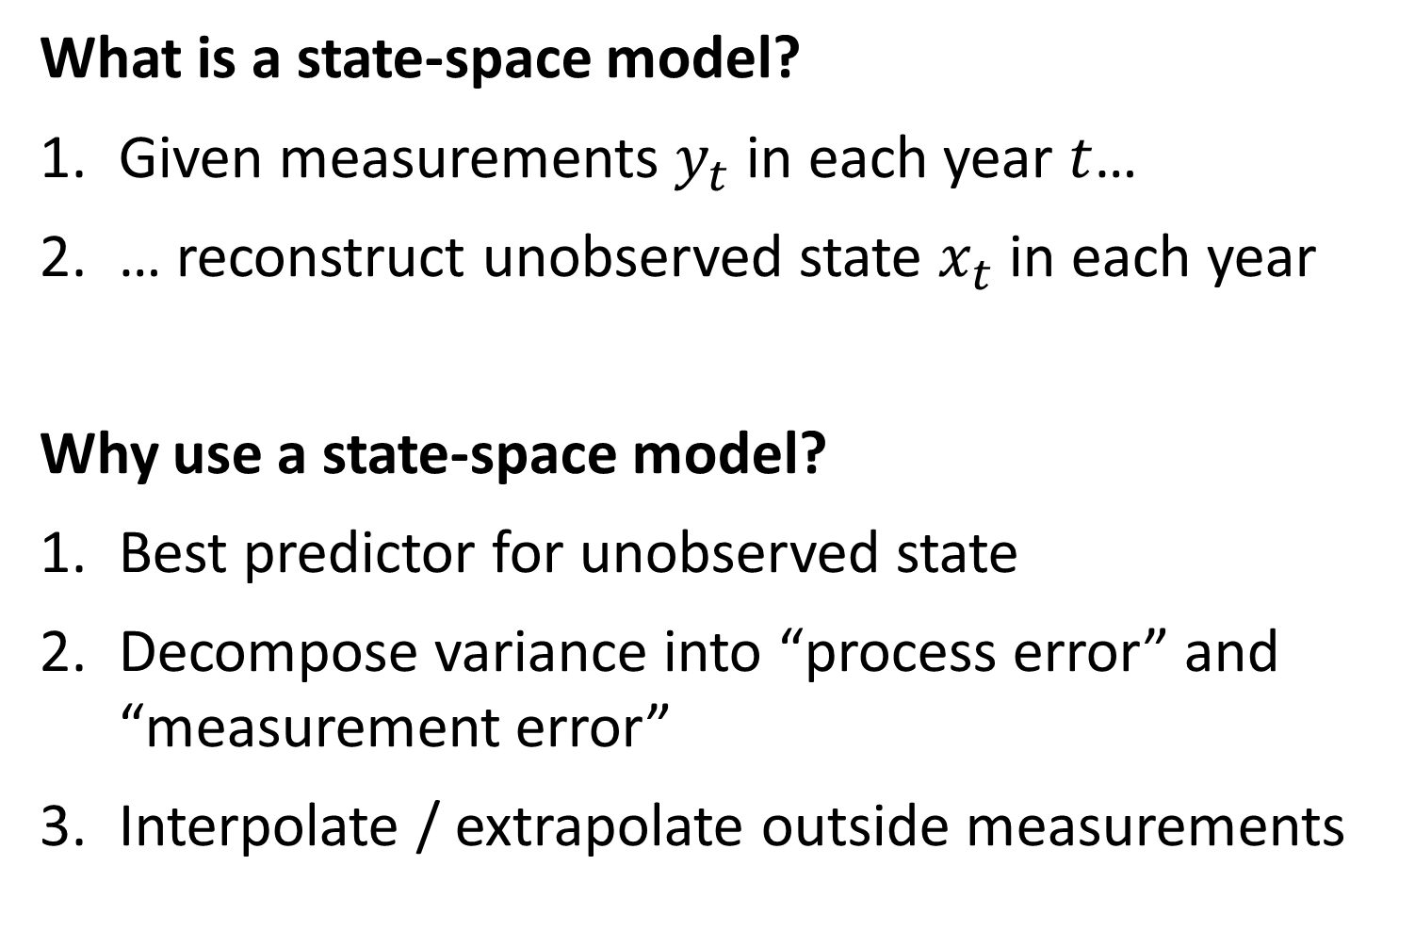
What is a state-space model?
Given measurements $y_{t}$ in each year $t$…
… reconstruct unobserved state $x_{t}$ in each year
Why use a state-space model?
Best predictor for unobserved state
Decompose variance into “process error” and “measurement error”
Interpolate / extrapolate outside measurements

Slide 6

Directed random walk
$$x_{t+1}=α+x_{t}+ε_{t}$$
$$ε_{t}\sim Normal(0,σ_{x}^{2})$$
$$log⁡(y_{t})\sim Normal(x_{t},σ_{y}^{2})$$
Time-series follows a random-walk with a trend $α$

Slide 7
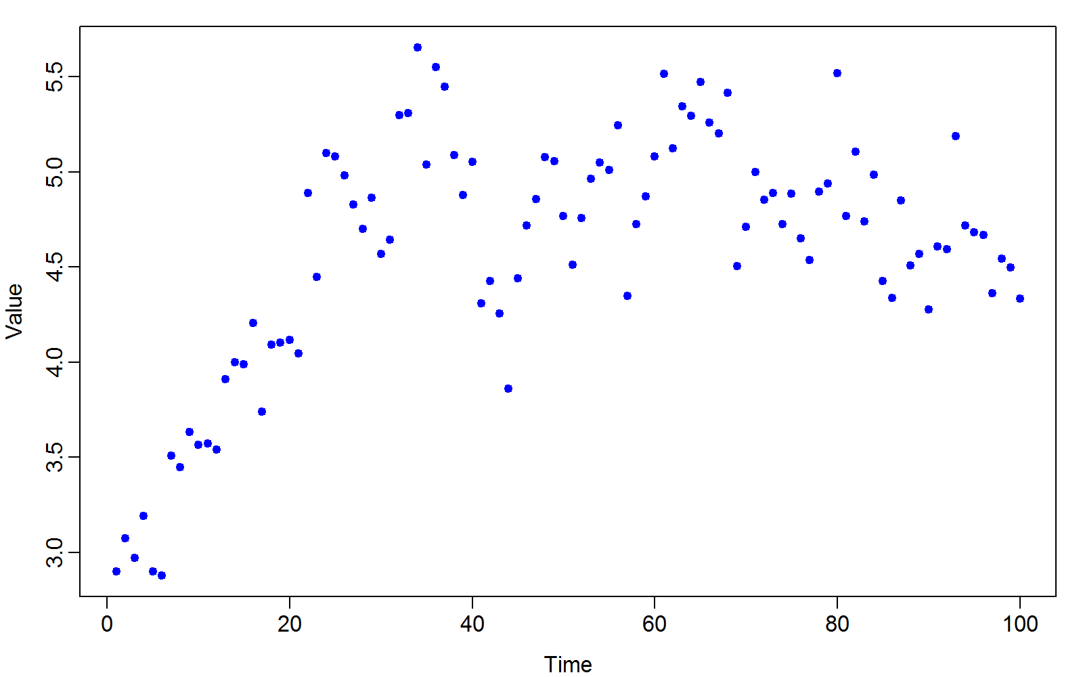
Data set

Slide 8
Approaches
Linear model
Loess smoother
Generalized additive model
Kalman filter

Slide 9
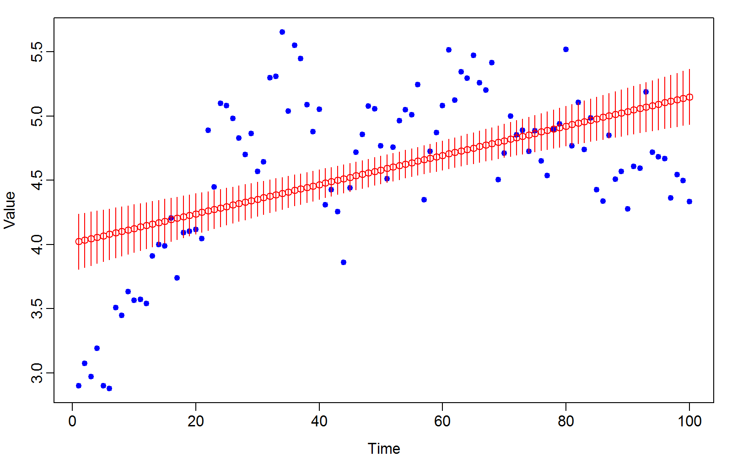
Linear model

Slide 10
Linear model
Problems
Huge residuals at beginning and ending
Predictive variance is larger at beginning and end of series
Doesn’t contain the true value very often
Not sufficiently flexible

Slide 11
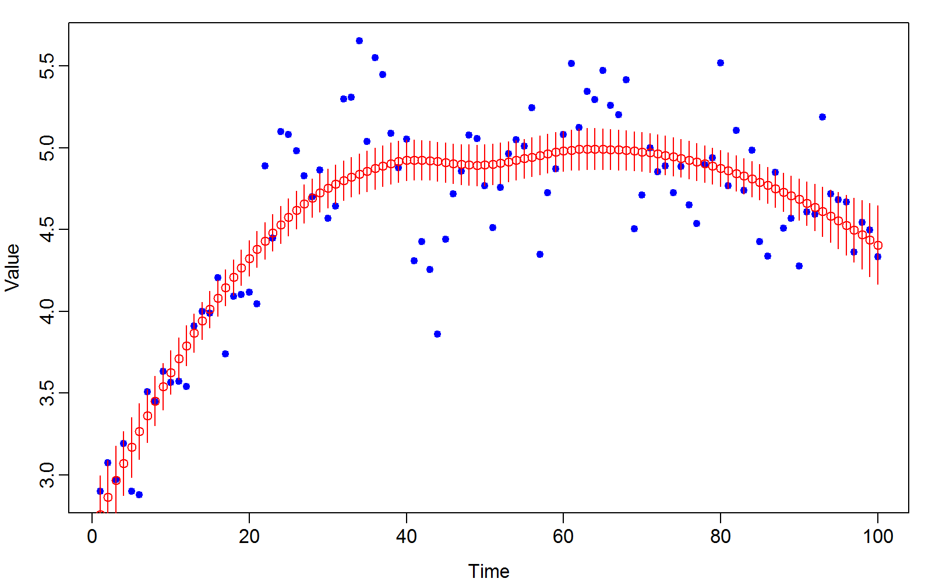
Loess smoother

Slide 12
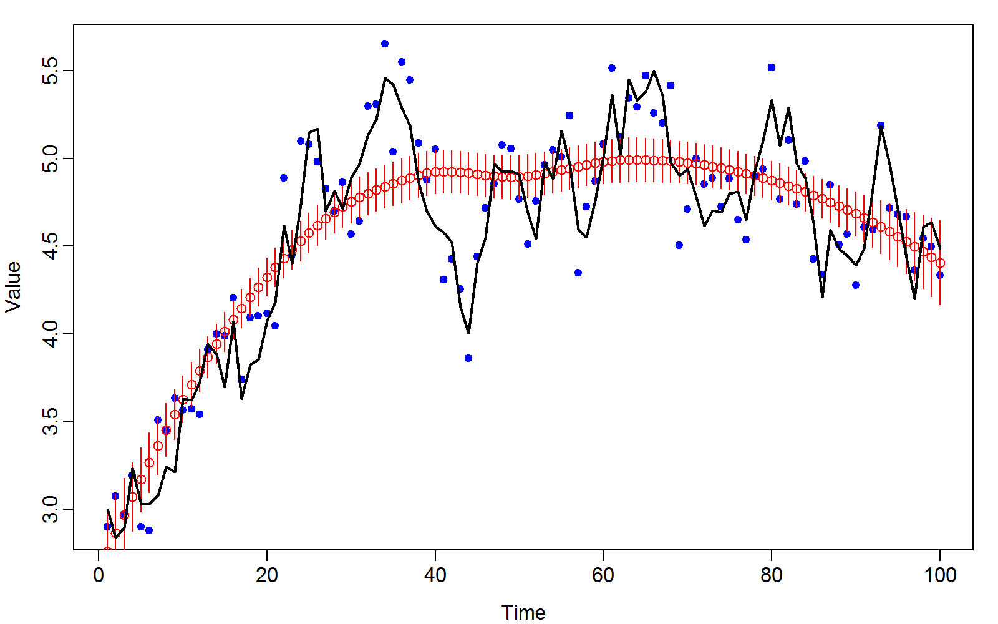
Loess smoother

Slide 13
Loess smoother
Problems
No model to specify
No interpretation of parameters as data-generating process
Confidence intervals don’t include the true values
Seems to “oversmooth”
i.e., strings of years are over/under-estimated

Slide 14
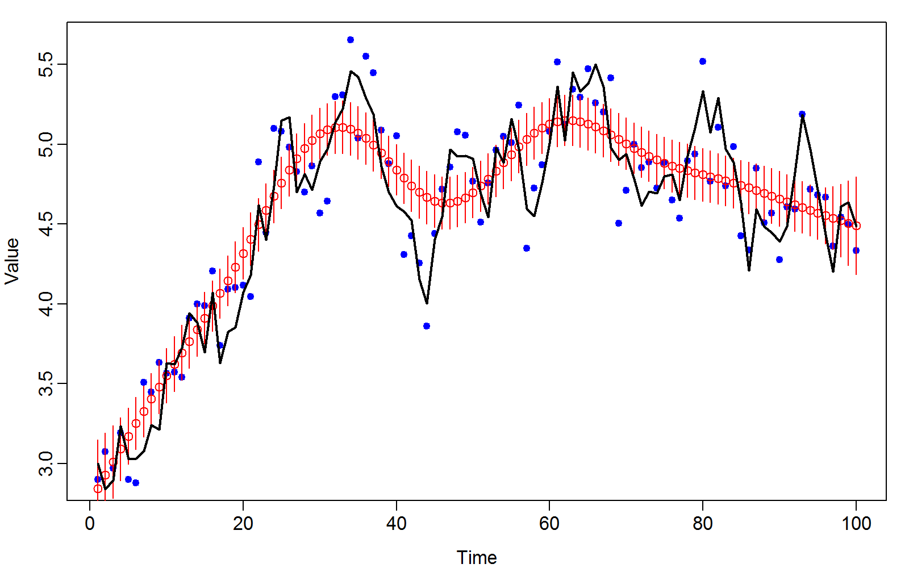
Generalized additive model

Slide 15
Generalized additive model
Problems
Confidence intervals don’t include the true values
Misses some fine-scale variation

Slide 16
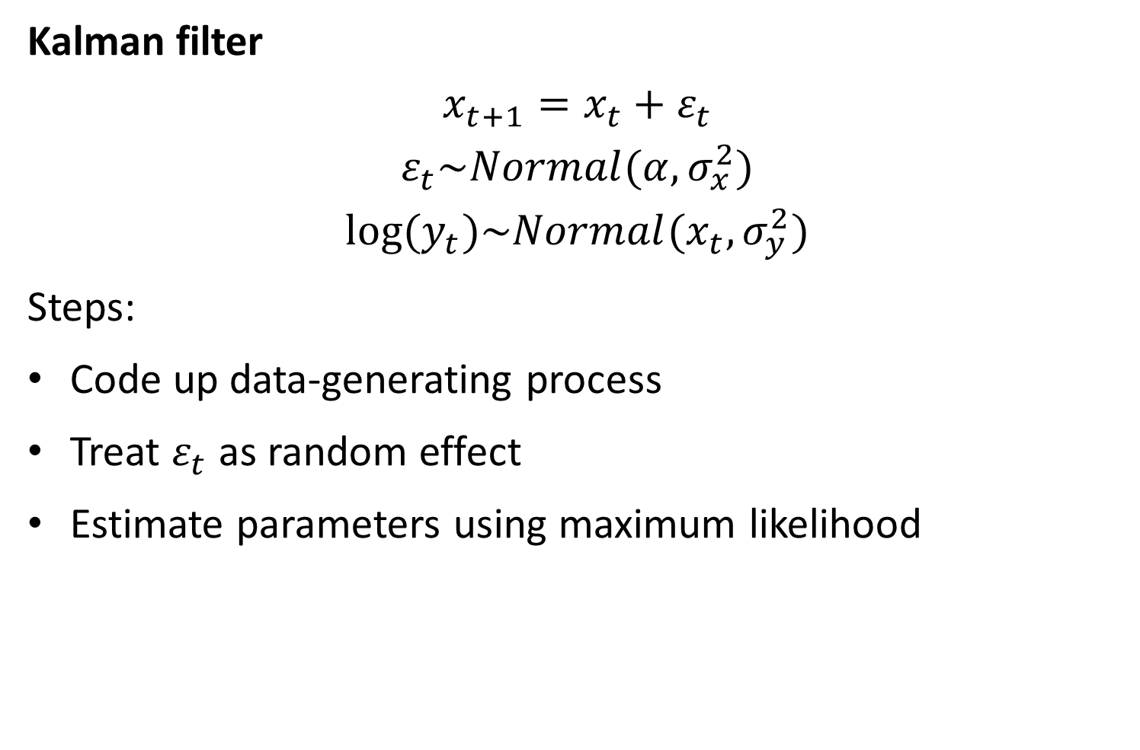
Kalman filter
$$x_{t+1}=x_{t}+ε_{t}$$
$$ε_{t}\sim Normal(α,σ_{x}^{2})$$
$$log⁡(y_{t})\sim Normal(x_{t},σ_{y}^{2})$$
Steps:
Code up data-generating process
Treat $ε_{t}$ as random effect
Estimate parameters using maximum likelihood

Slide 17
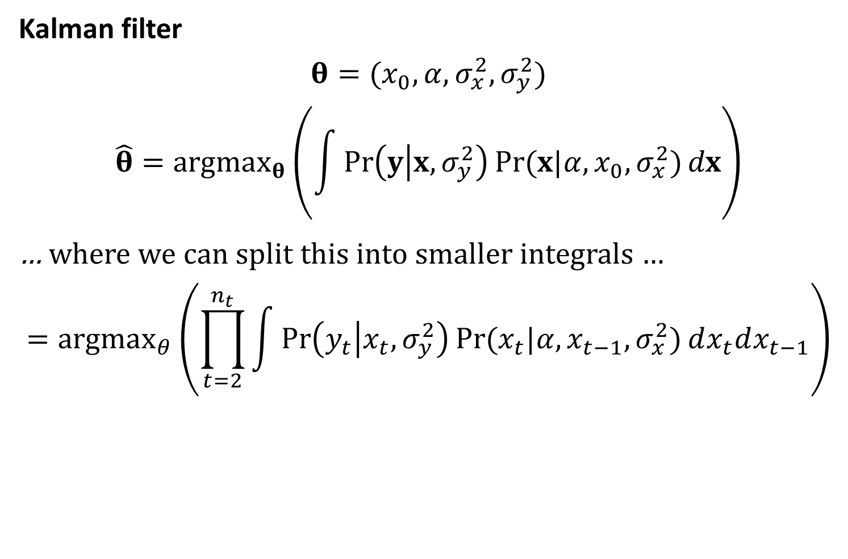
Kalman filter
$$θ=(x_{0},α,σ_{x}^{2},σ_{y}^{2})$$
$$\hat{θ}={argmax}_{θ}\left(\int{\operatorname{Pr}\left(y | x,σ_{y}^{2}\right)Pr⁡(x|α,x_{0},σ_{x}^{2})}dx\right)$$
… where we can split this into smaller integrals …
$$={argmax}_{θ}\left(\prod_{t=2}^{n_{t}}{\int{\operatorname{Pr}\left(y_{t} | x_{t},σ_{y}^{2}\right)Pr⁡(x_{t}|α,x_{t−1},σ_{x}^{2})}}dx_{t}dx_{t−1}\right)$$

Slide 18
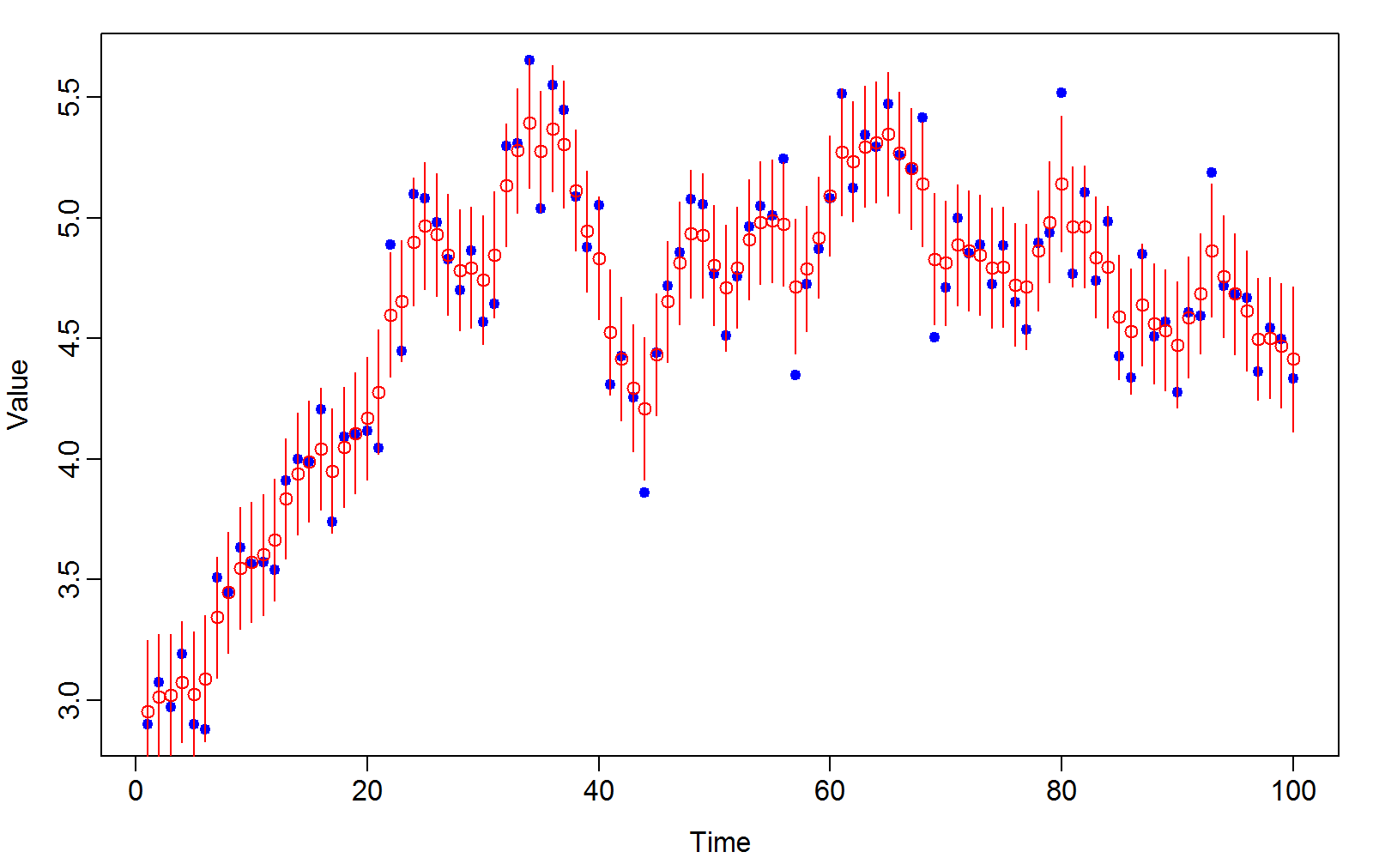
Kalman filter

Slide 19
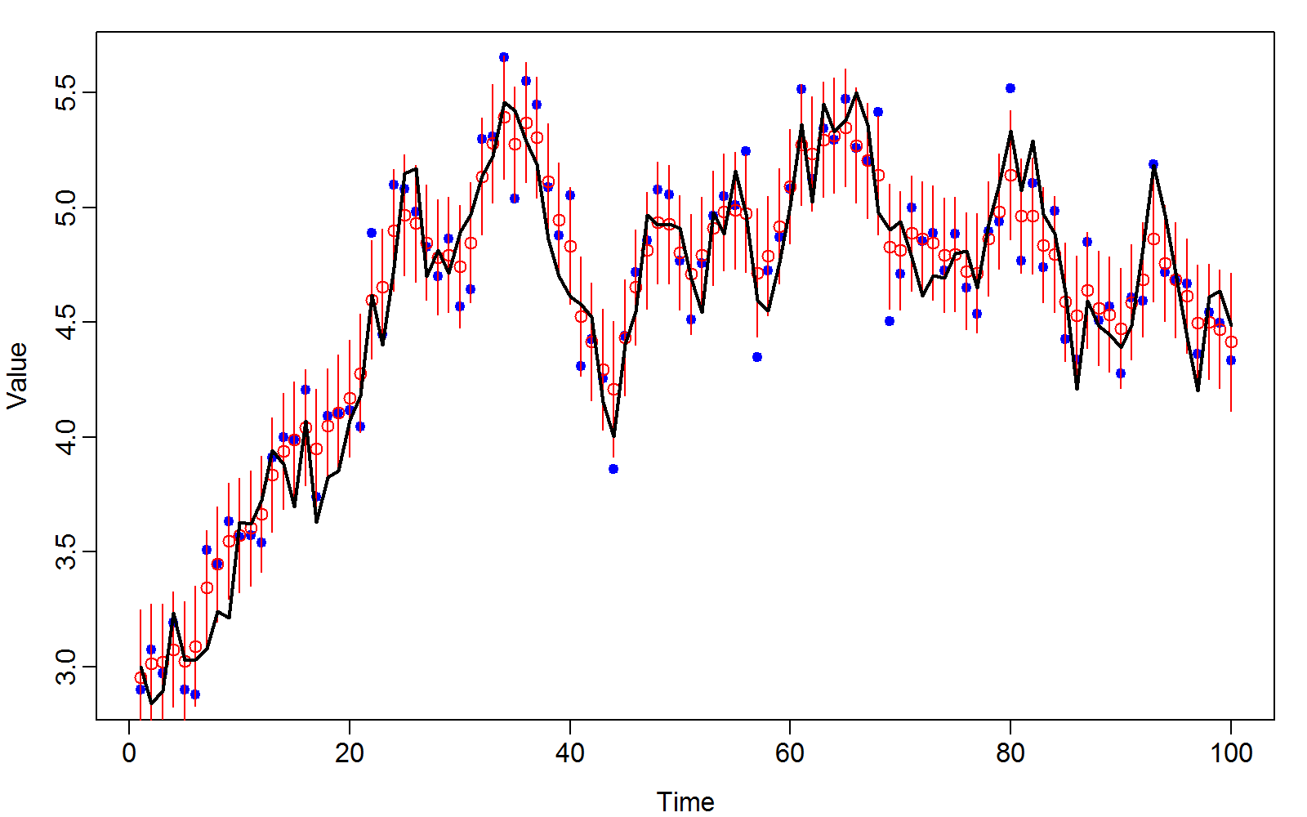
Kalman filter

Slide 20
Kalman filter
Improvements
Specifies an explicit model
Confidence intervals include the true values
Seems to behave intuitively
Predictions are shrunk towards data, and neighboring predictions

Slide 21

Directed random walk
$$x_{t+1}=x_{t}+ε_{t}$$
$$ε_{t}\sim Normal(α,σ_{x}^{2})$$
$$log⁡(y_{t})\sim Normal(x_{t},σ_{y}^{2})$$
Time-series follows a random-walk with a trend $α$

Slide 22
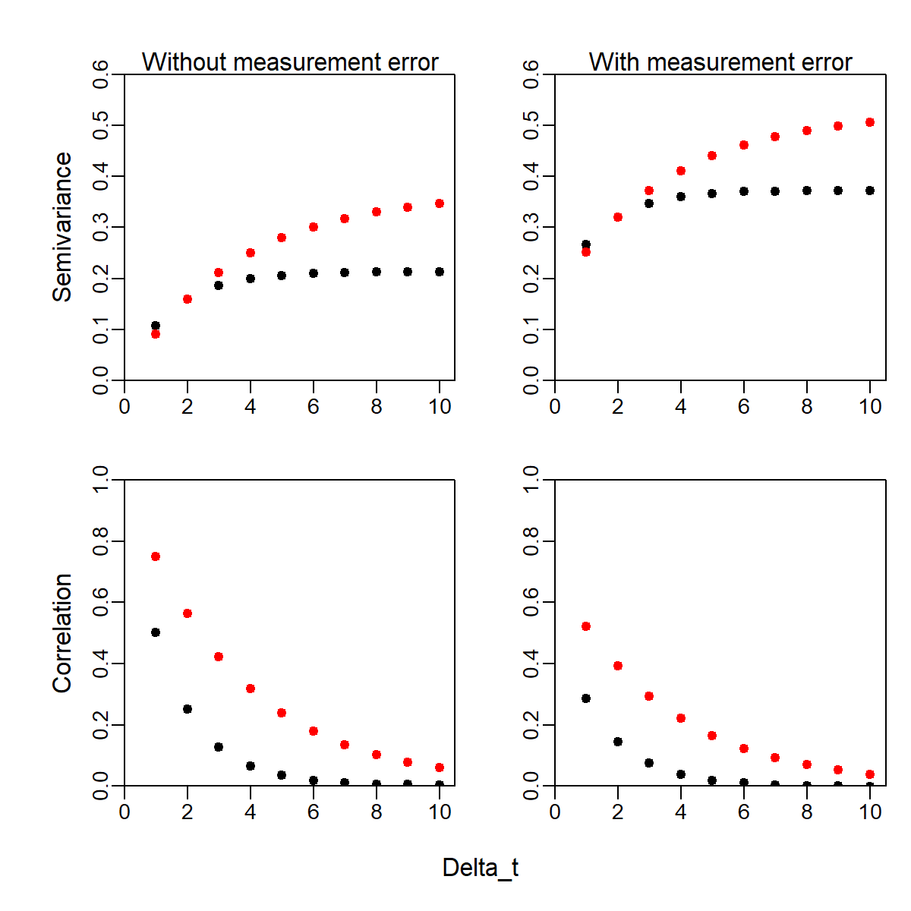
Semivariance
Semivariogram
Half of expected variance for difference between two measurements
Properties
Sill: Variance at infinite distance
Nugget: Variance at zero distance

Slide 23
Semivariance
Correlation function
Only calculable when semivariance is stationary
Properties
Range: Distance at 10% correlation

Slide 24
Data set

Slide 25
Questions
Is there evidence of density dependence?
If yes, what is the expected equilibrium?
What is the stationary distribution?
Variance
How “stable” is the model
Reactivitiy
Resilience
Resistence

Slide 26
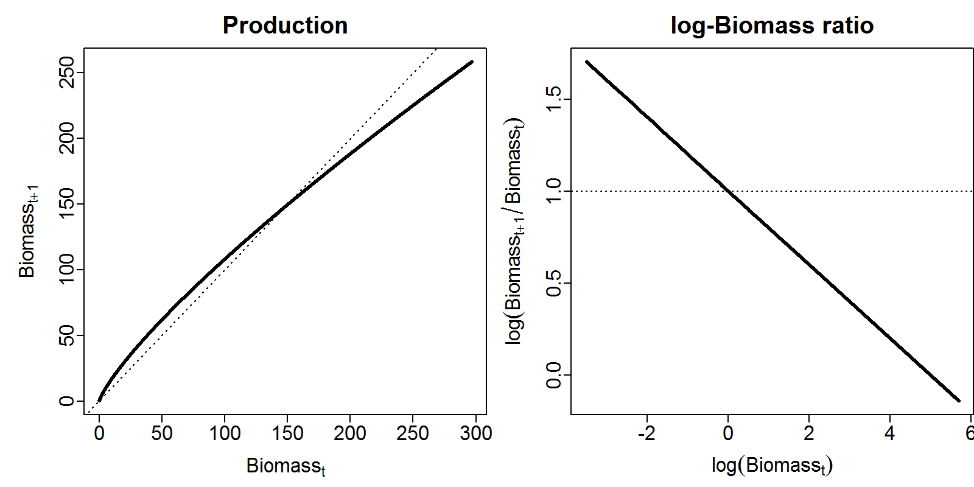

Gompertz model
$$b_{t+1}=d_{t}\exp\left(α−β{log⁡(d}_{t})+ε_{t}\right)$$
$$ε_{t}\sim Normal(0,σ_{d}^{2})$$
$$log⁡(b_{t})\sim Normal\left(log⁡(d_{t}),σ_{b}^{2}\right)$$

Slide 27
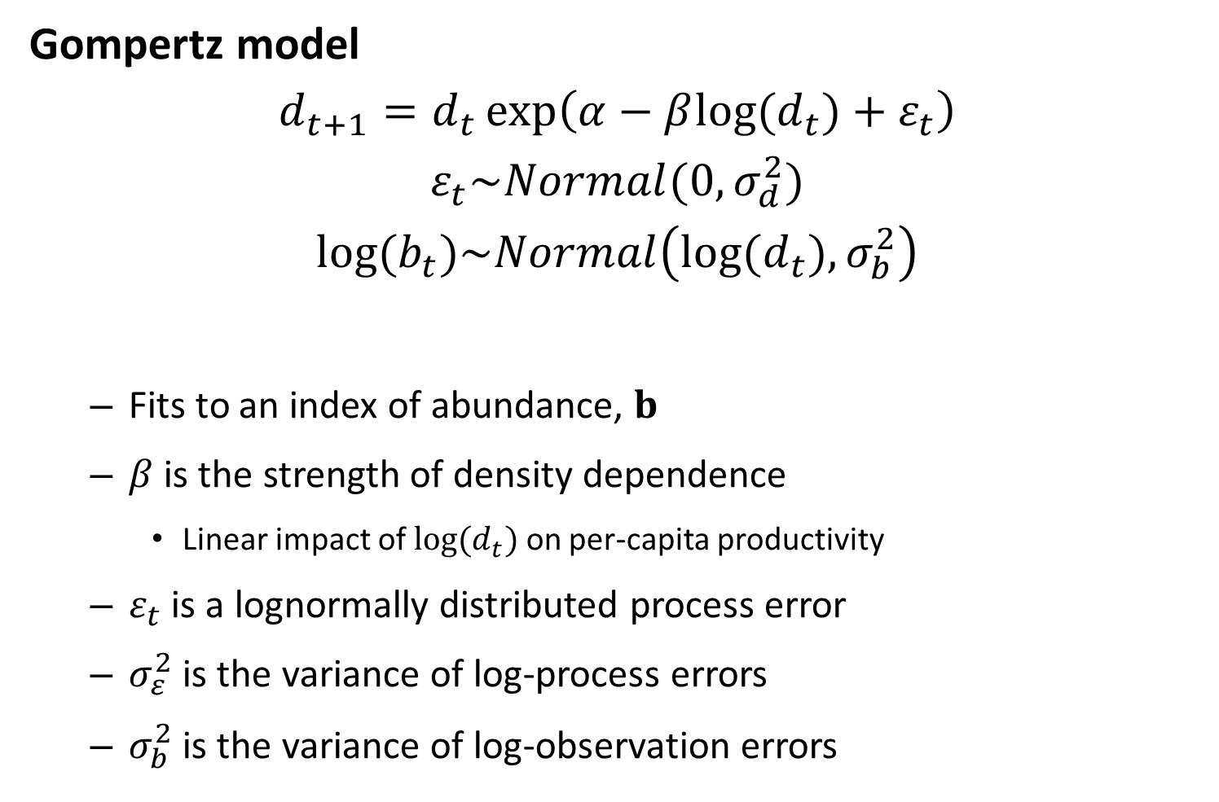
Gompertz model
$$d_{t+1}=d_{t}\exp\left(α−β{log⁡(d}_{t})+ε_{t}\right)$$
$$ε_{t}\sim Normal(0,σ_{d}^{2})$$
$$log⁡(b_{t})\sim Normal\left(log⁡(d_{t}),σ_{b}^{2}\right)$$
Fits to an index of abundance, $b$
$β$ is the strength of density dependence
Linear impact of ${log⁡(d}_{t})$ on per-capita productivity
$ε_{t}$ is a lognormally distributed process error
$σ_{ε}^{2}$ is the variance of log-process errors
$σ_{b}^{2}$ is the variance of log-observation errors

Slide 28
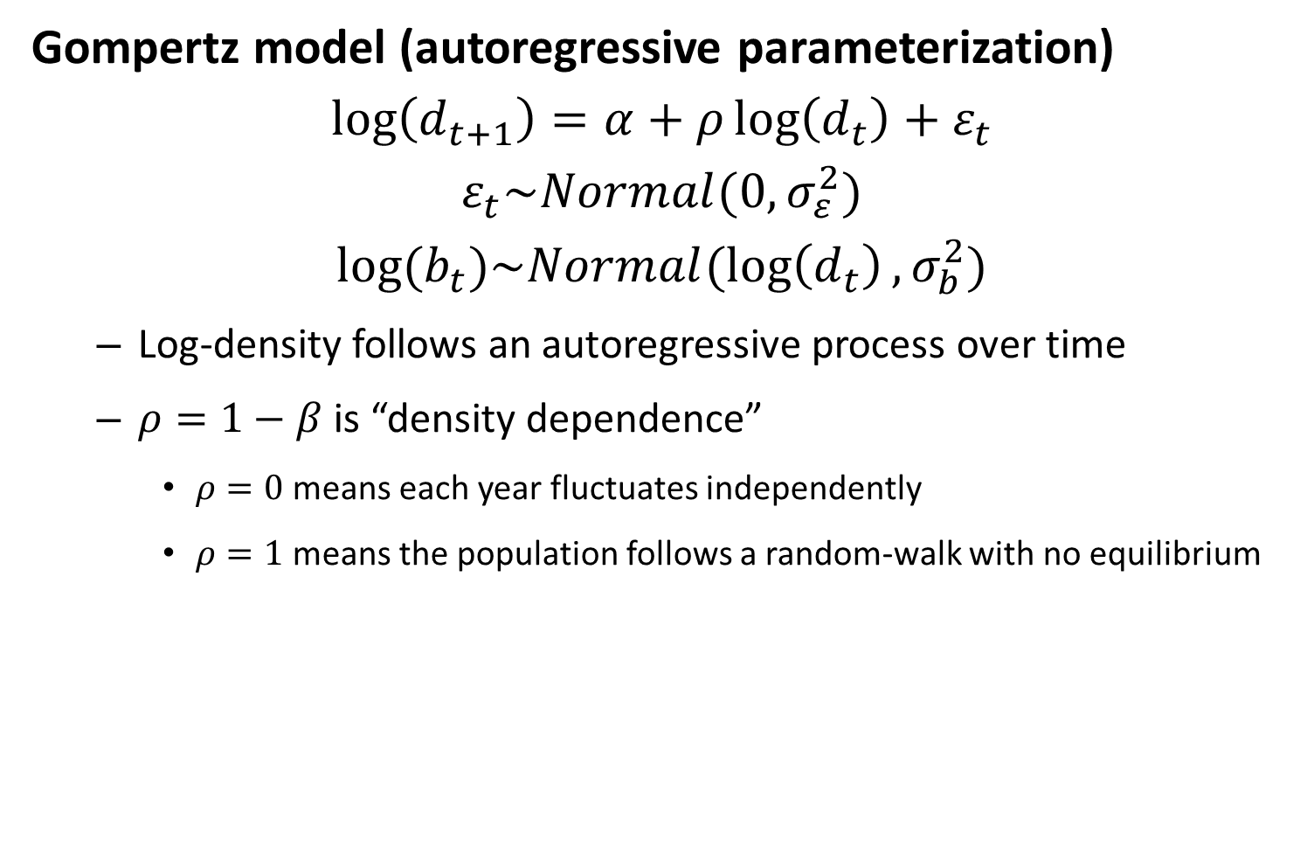
Gompertz model (autoregressive parameterization)
$$\log\left(d_{t+1}\right)=α+ρ\log\left(d_{t}\right)+ε_{t}$$
$$ε_{t}\sim Normal(0,σ_{ε}^{2})$$
$$log⁡(b_{t})\sim Normal(\log\left(d_{t}\right),σ_{b}^{2})$$
Log-density follows an autoregressive process over time
$ρ=1−β$ is “density dependence”
$ρ=0$ means each year fluctuates independently
$ρ=1$ means the population follows a random-walk with no equilibrium

Slide 29
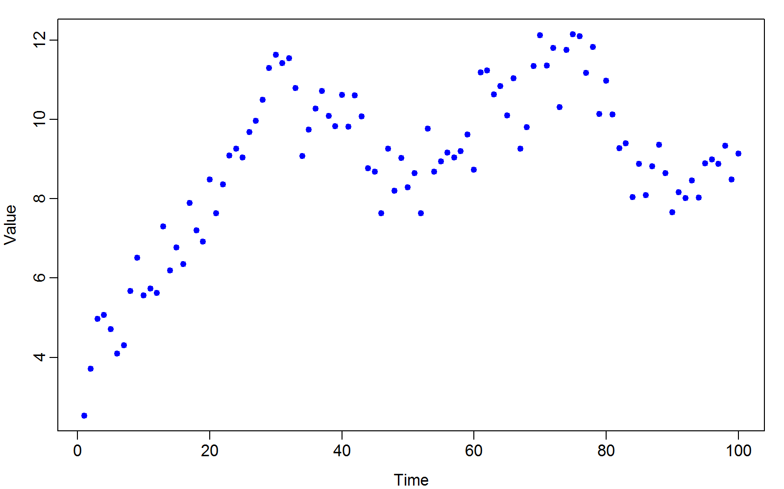
Gompertz model (autoregressive parameterization)

Slide 30
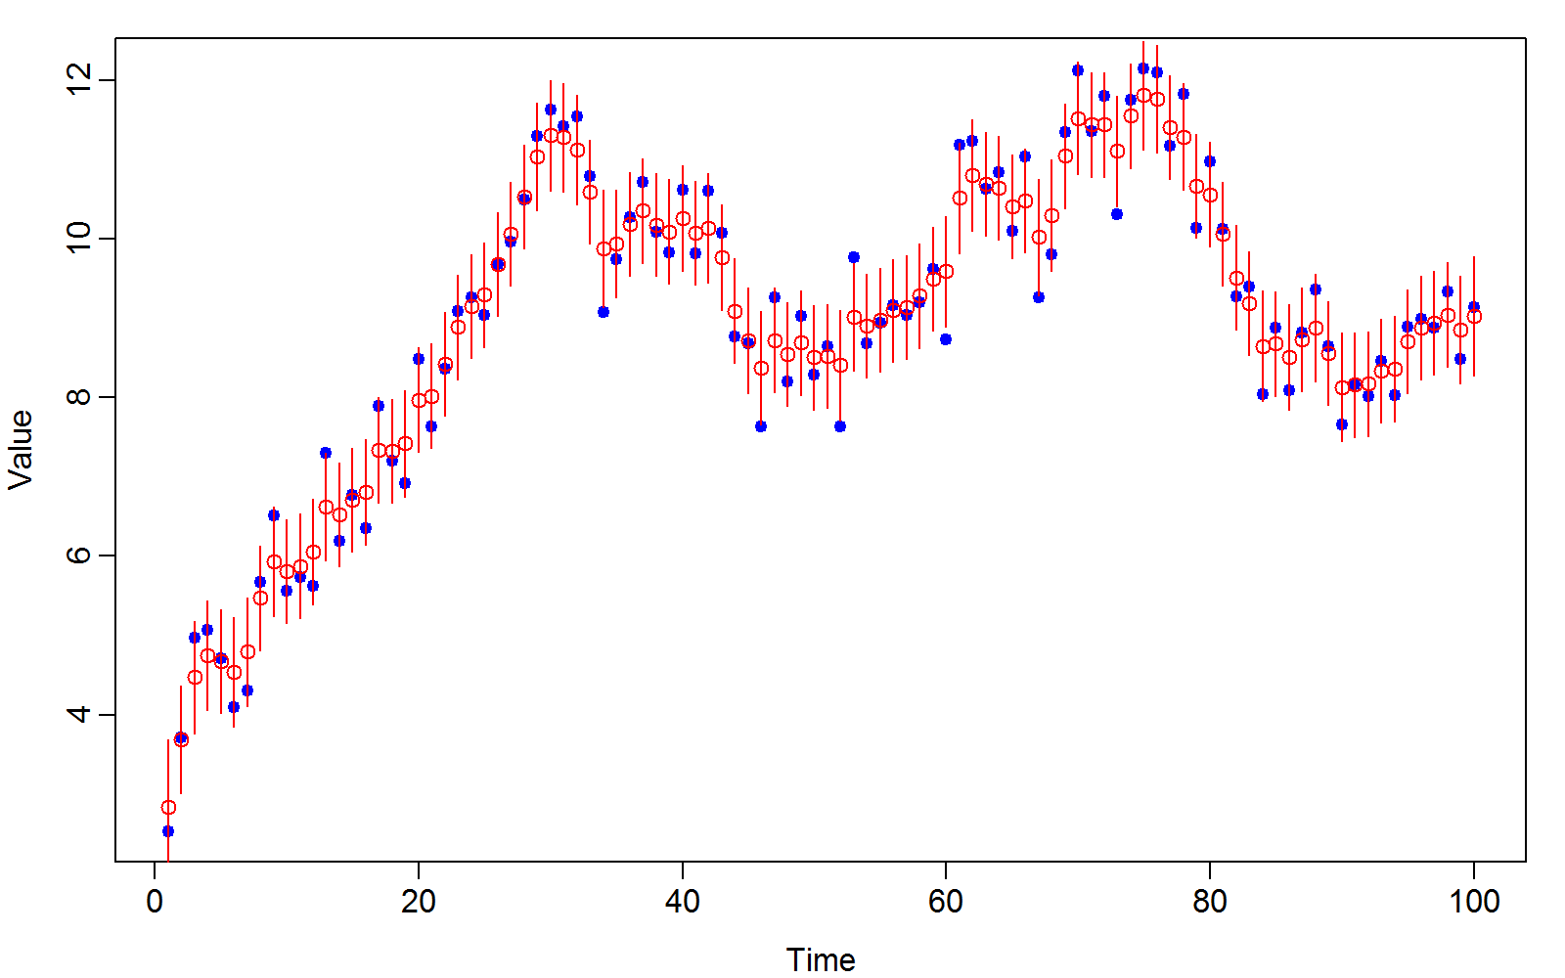
Gompertz model (autoregressive parameterization)

Slide 31
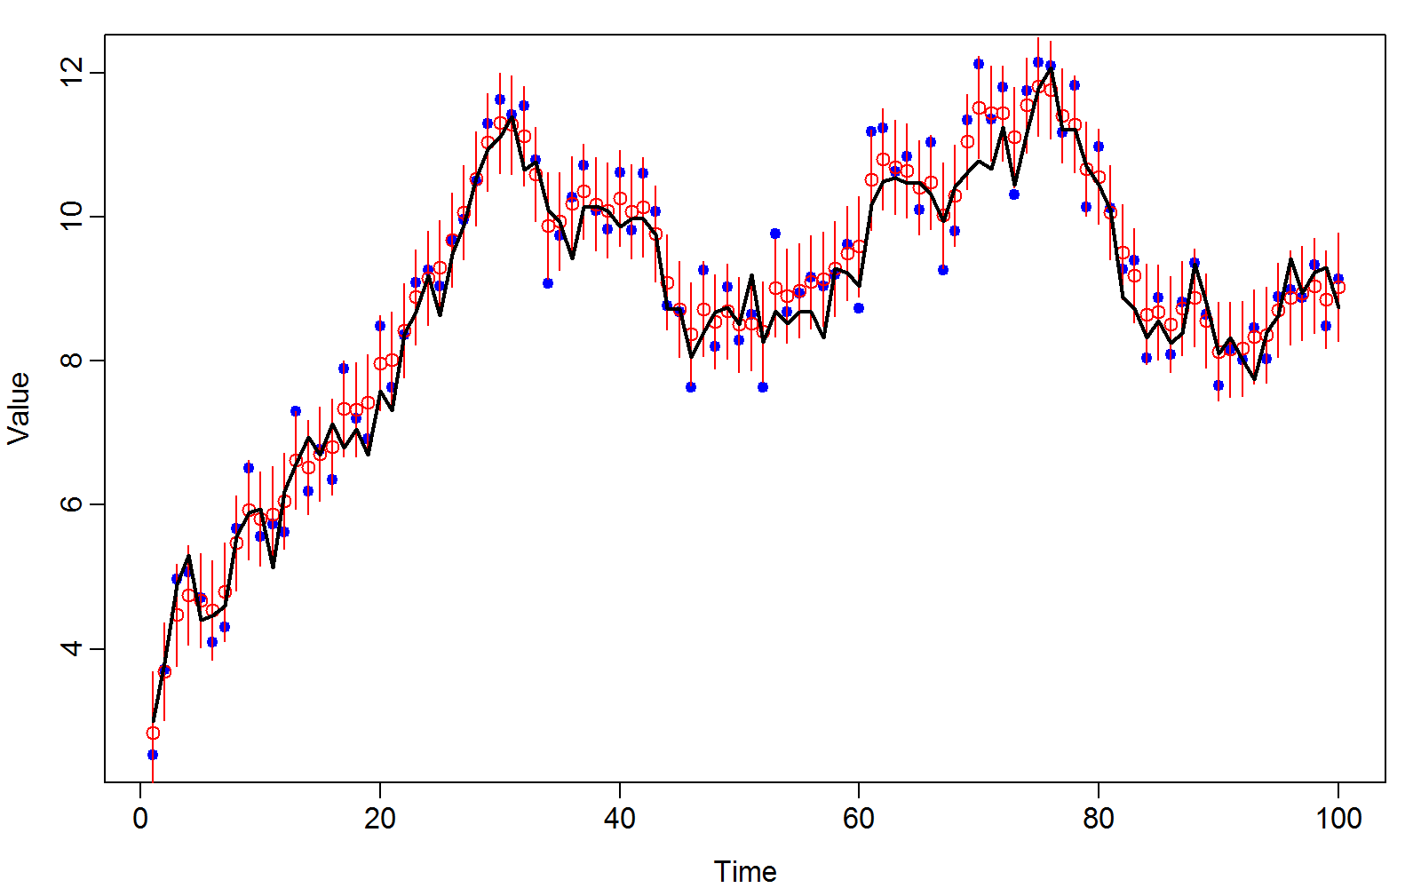
Gompertz model (autoregressive parameterization)

Slide 32

Gompertz model (autoregressive parameterization)
$$x=Bx+ε$$
$$ε\sim MVN(0,V)$$
Where:
$$B=\left[\begin{matrix}0 & 0 & 0 & 0 & … & 0 \\ ρ & 0 & 0 & 0 & … & 0 \\ 0 & ρ & 0 & 0 & … & 0 \\ 0 & 0 & ρ & 0 & … & … \\ … & … & … & … & … & … \\ 0 & 0 & 0 & 0 & … & 0\end{matrix}\right]$$
And
$$V=\left[\begin{matrix}\frac{σ^{2}}{1−ρ^{2}} & 0 & 0 & 0 & … & 0 \\ 0 & σ^{2} & 0 & 0 & … & 0 \\ 0 & 0 & σ^{2} & 0 & … & 0 \\ 0 & 0 & 0 & σ^{2} & … & … \\ … & … & … & … & … & … \\ 0 & 0 & 0 & 0 & … & σ^{2}\end{matrix}\right]$$
Boundary effect

Slide 33
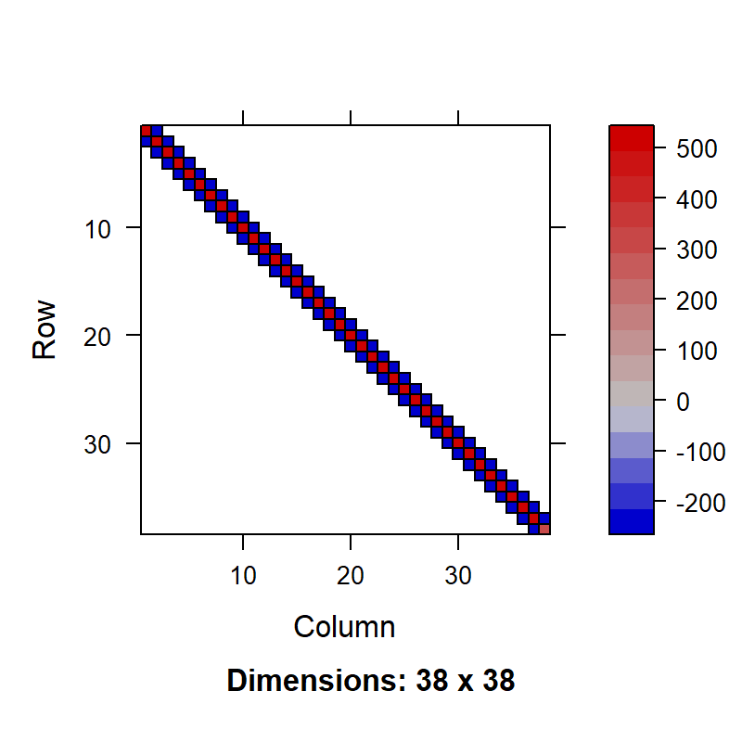

Gompertz model (autoregressive parameterization)
Working with the precision (inverse-covariance):
$$Q=Σ^{−1}={\left(I−B\right)}^{t}V^{−1}\left(I−B\right)$$
A few notes:
$Q$ is sparse (many elements = 0)
$Q$ is tri-diagonal

Slide 34
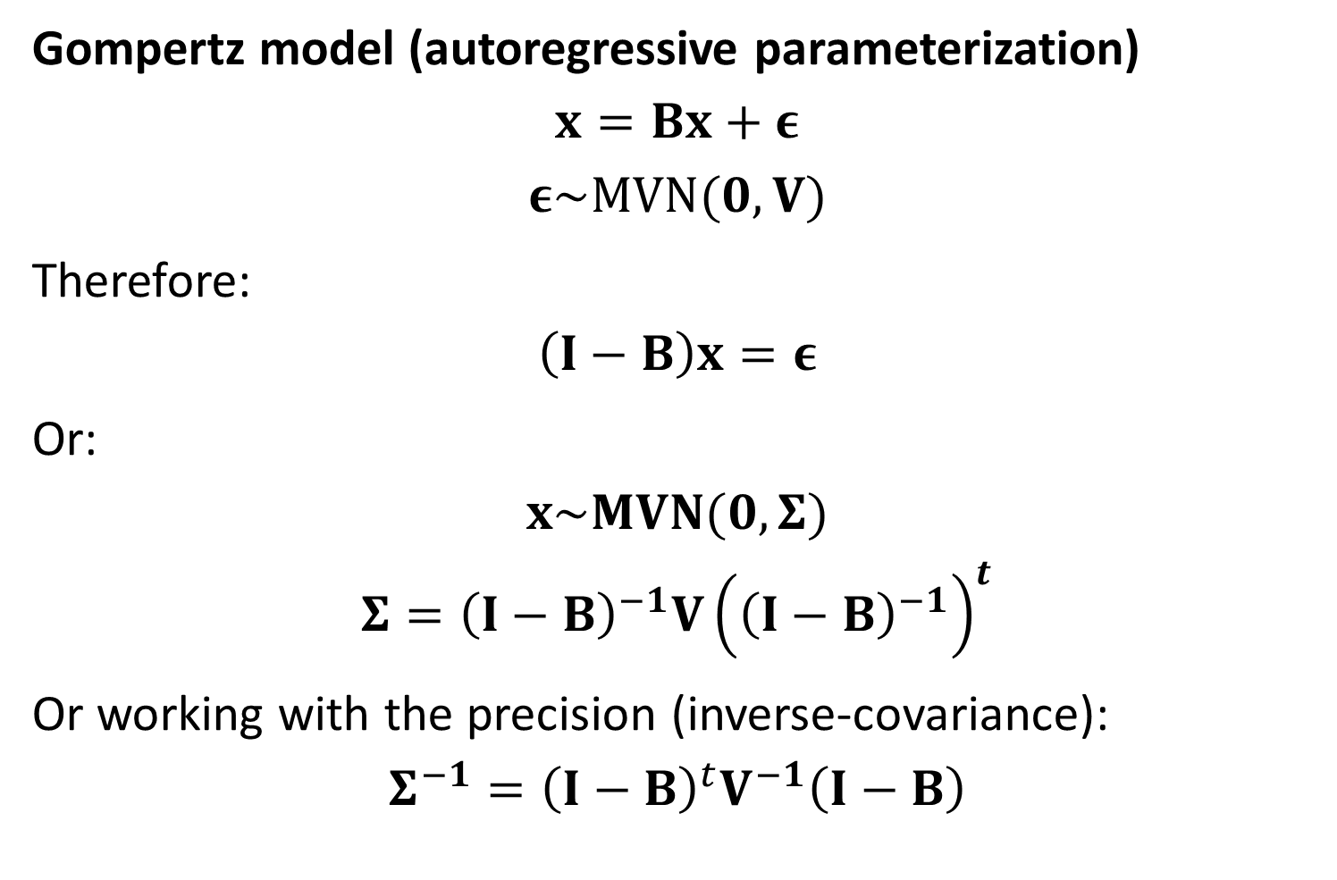
Gompertz model (autoregressive parameterization)
$$x=Bx+ε$$
$$ε\sim MVN(0,V)$$
Therefore:
$$\left(I−B\right)x=ε$$
Or:
$$x\sim MVN(0,Σ)$$
$$Σ={\left(I−B\right)}^{−1}V{\left({\left(I−B\right)}^{−1}\right)}^{t}$$
Or working with the precision (inverse-covariance):
$$Σ^{−1}={\left(I−B\right)}^{t}V^{−1}\left(I−B\right)$$

Slide 35
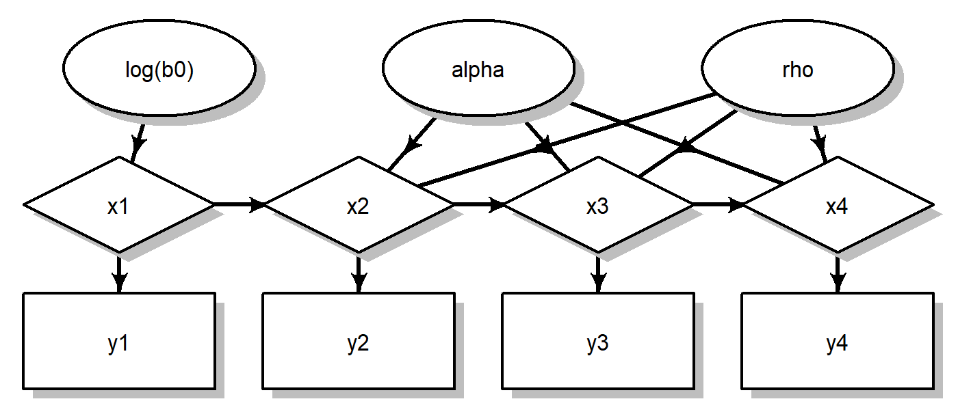
Gompertz model (autoregressive parameterization)
Separability
Sparse Hessian matrix
Conditional independence
Graphical model has random effects without downstream connection, or lateral connection

